Slide 1

Joel Adams – Portfolio Website

Slide 2
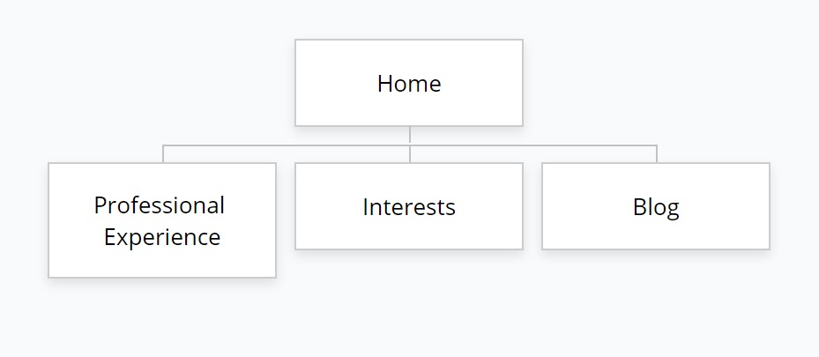
Sitemap

Slide 3
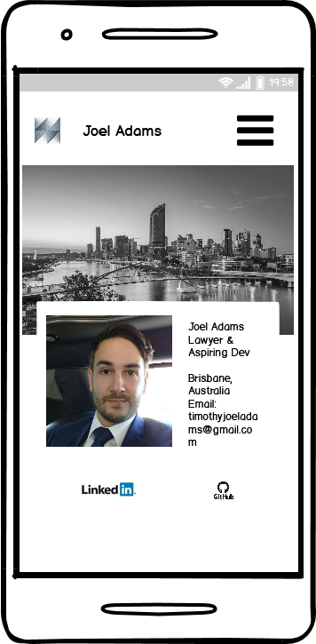
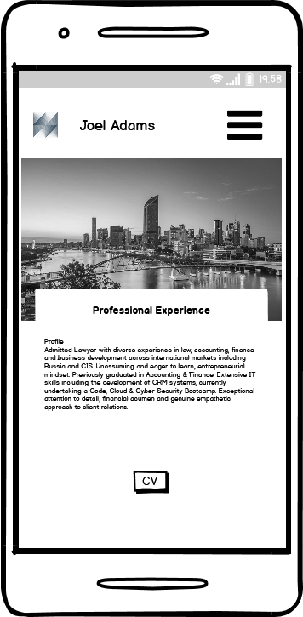
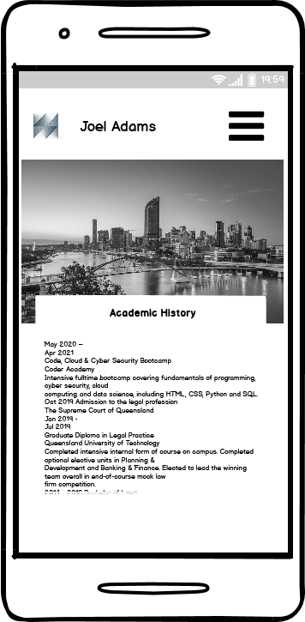
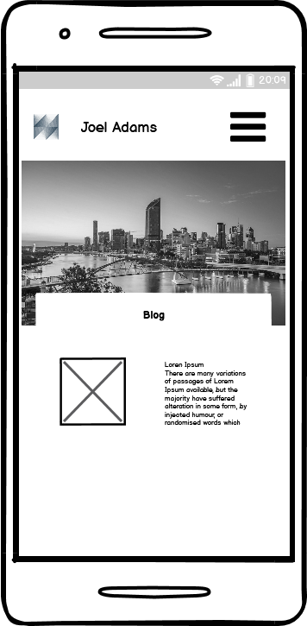
Wire Frames - Mobile

Slide 4
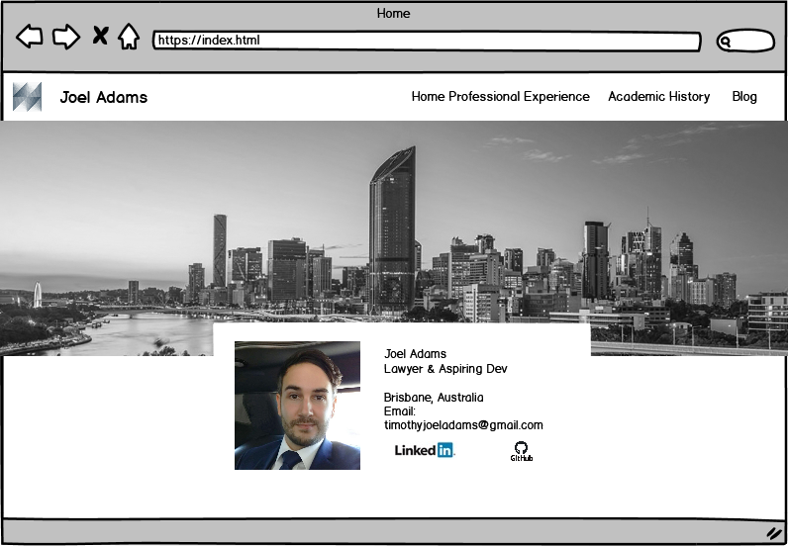
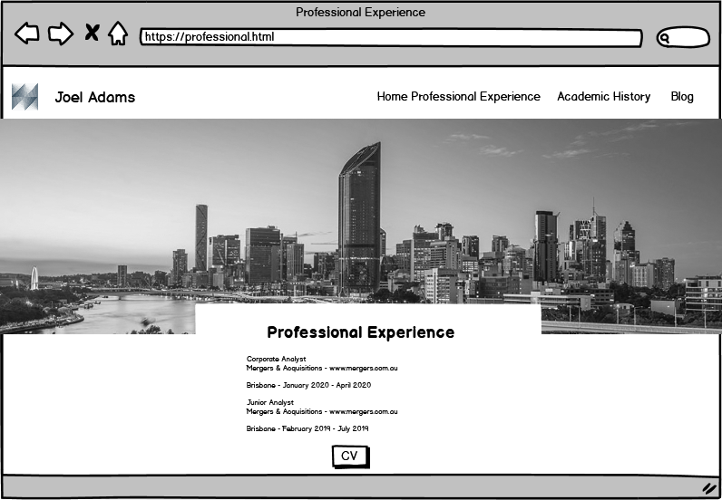
Wire Frames – Desktop 1

Slide 5
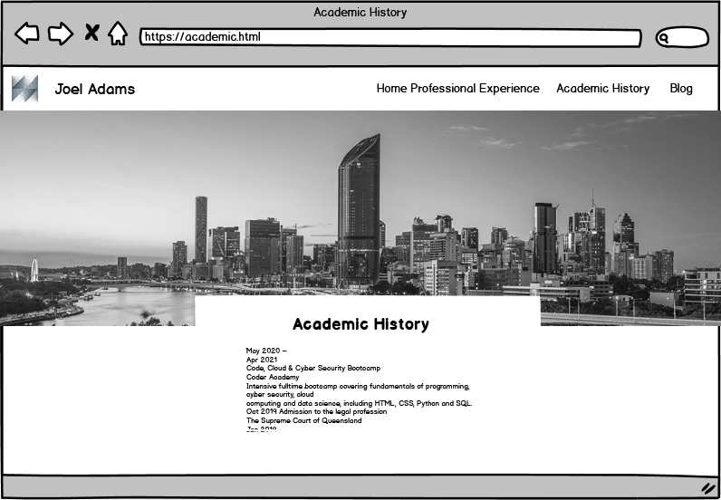
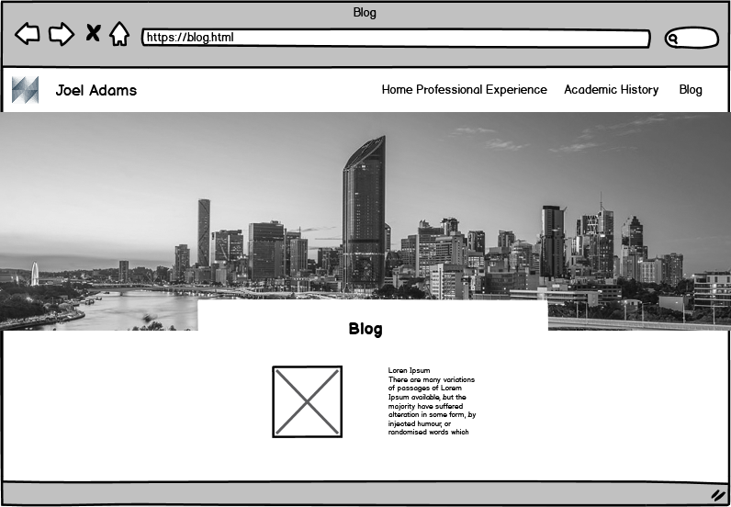
Wire Frames – Desktop 2

Slide 6
> Go to site
Design/Styling comments
Semi grayscale overall appearance as my target audience is in the legal sector and I felt this would be professional.
Backdrop of the Brisbane skyline, the same image which I have on my Linkedin Page.
I experimented with a ranged of colours before this but felt most of the colour images I tried were too distracting.

Slide 7
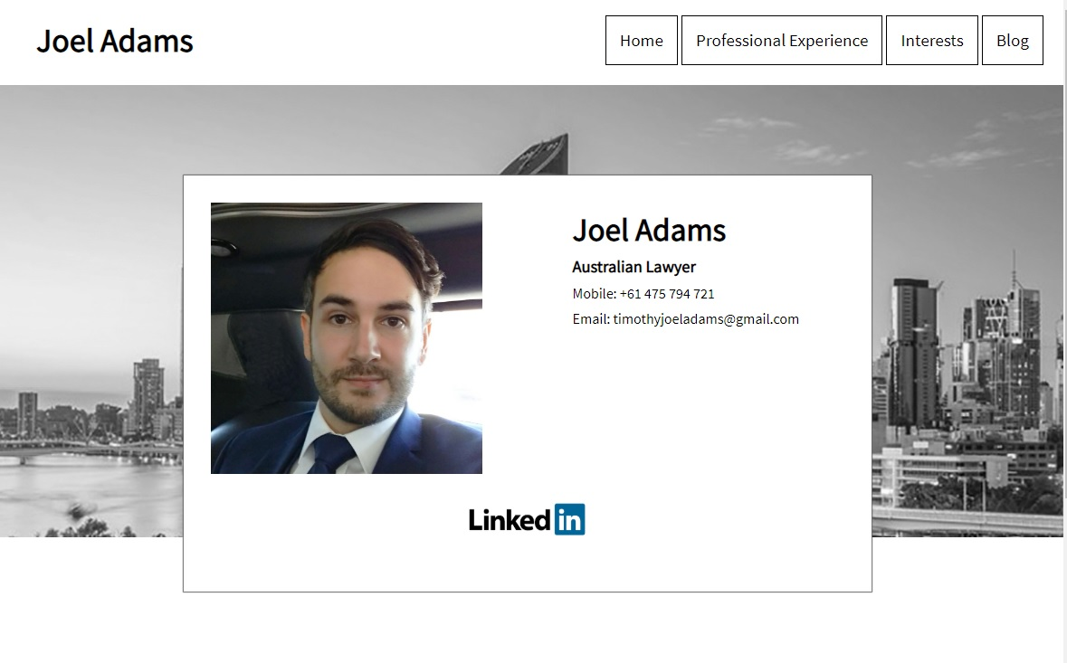
Components - Home
section
div - “header_block”
div - "name"
H1 - Joel Adams
div - "navdiv"
ul - "navbar"
li class -"navbarline” – for each link
a href -for each link
Section
div - "header_image_div”
div - "floating"
div - “profile_image”
div id – “profile_text”
H2 - Joel Adams
H3 - Australian Lawyer
P - contact details
div - "social_bar"
a href + img – “Linkedin”

Slide 8
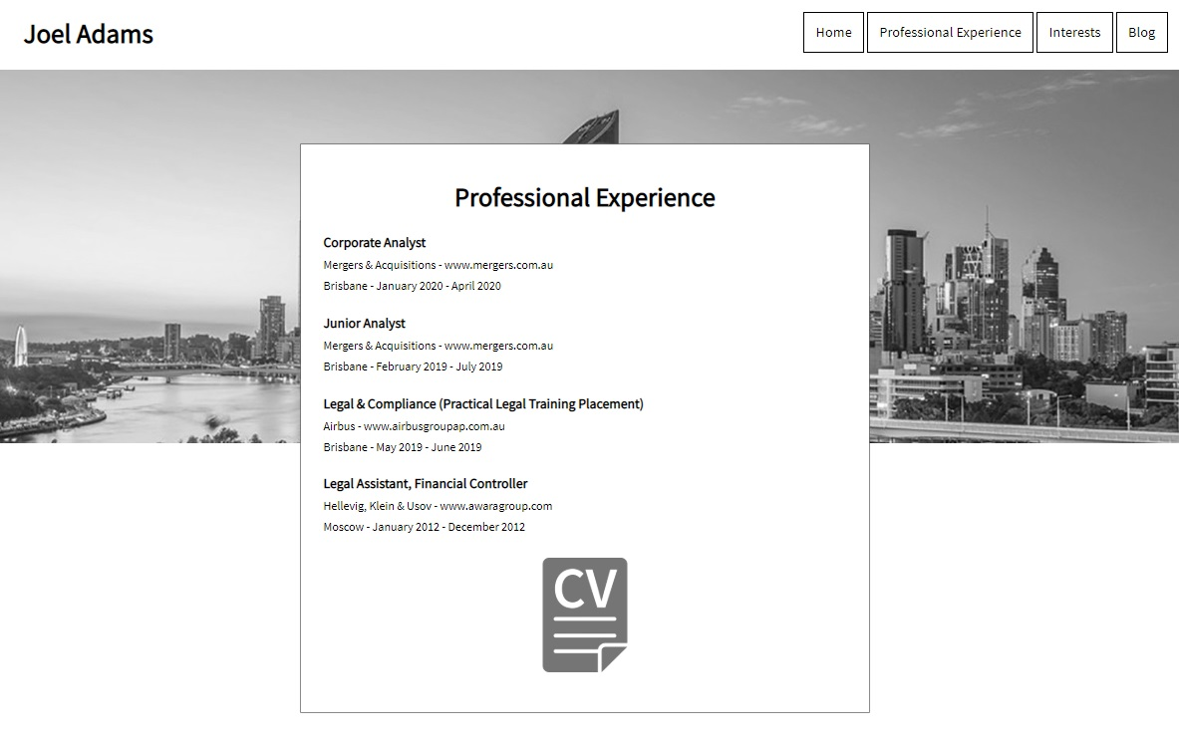
Components - Professional
section
div - “header_block”
div - "name"
H1 - Joel Adams
div - "navdiv"
ul - "navbar"
li class -"navbarline”
a href -for each link
Section
div - "header_image_div”
div - "floating"
Div – “cv text”
H2 – Professional Experience
H3 – Position Name – for each position
P – other text for each position
div - "social_bar"
a href + img – “cv pdf”

Slide 9
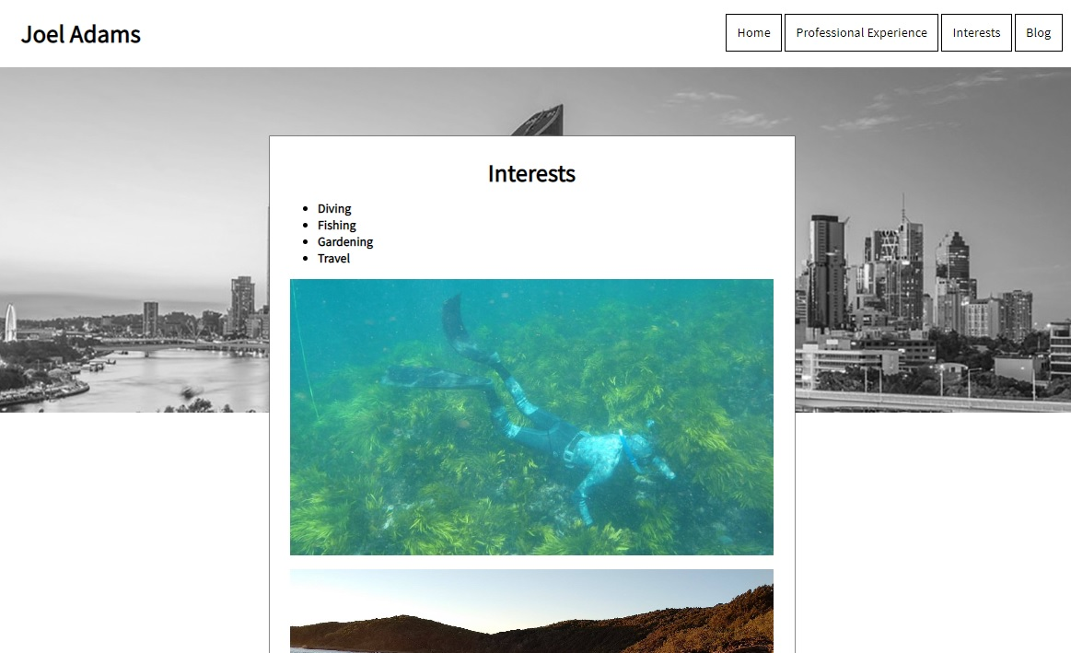
Components - Interests
section
div - “header_block”
div - "name"
H1 - Joel Adams
div - "navdiv"
ul - "navbar"
li class -"navbarline”
a href -for each link
Section
div - "header_image_div”
div - "floating"
Div – “Title Text”
H2 – Interests
Div – “interests_text”
Ul – for each interest
Div with background image – for each interest image x4

Slide 10
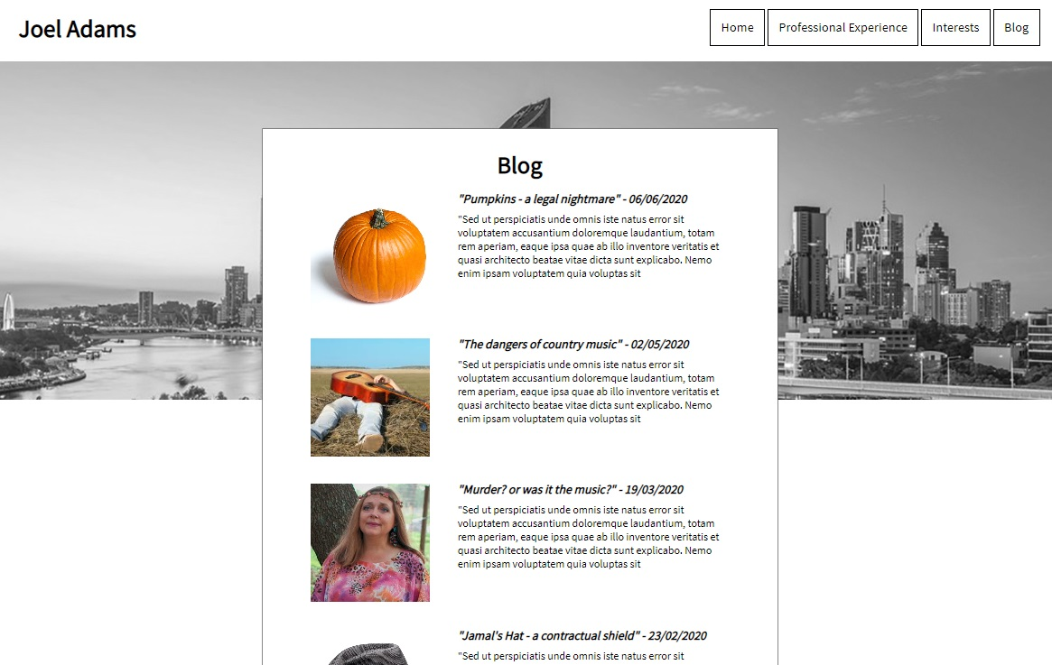
Components - Blog
section
div - “header_block”
div - "name"
H1 - Joel Adams
div - "navdiv"
ul - "navbar"
li class -"navbarline”
a href -for each link
Section
div - "header_image_div”
div - "floating"
Div – “Title Text”
H2 – Blog
Div – “blog text” x4
Div with background image – for each interest image x4

Slide 11
Main Design Challenges, Stages, Comments
Realised I had misread the requirements and actually needed an ‘interests page’ instead of my original wireframes.
Buttons at top navigation not working, bunching up when resizing width – flex fixed this for the desktop site at first.
Header/banner image was spanning incorrectly when the window resized – Garret showed me how to use a div with a background image which fixed this and allowed the image to zoom out or in from the centre to fit the size.
The main floating divs which contained all the page content would change position depending on size – setting an ‘absolute’ px distance from the top of the page fixed this.
The main floating divs were not sizing according the screen width, I went back and read about media queries and also got help from Garret and decided on two sizes for ‘min-width settings’ – 600 and 850, allowing for three sizes in total when considering <600 (mobile-first)
After I adjusted the media queries my top nav bar began not to work and I considered using a javascript ‘hamburger’ button, but decided to keep it simple, within our lesson content and stack the buttons as block display.
A large help for me for resizing and spacing text was the discovery of the ‘em’ sizing and ‘margin-block, start and end’.
The most fun was finding the blog images.

